Slide 1
Using R Statistical Software for DoE
Brett Gytri – Tissue-Grown Corporation

Slide 2
Overview
Why R?
R Overview -Learning Enough R for DoE
DoE with R

Slide 3
Why R?
R is a programming language created by statisticians for data analysis.
Open-source programming language means it is extensible with state-of-the-art statistical methodologies regularly made available from the experts to make the life of a data analyst easier.
Excellent data manipulation and visualization capabilities.
Scripting-language means that the research you do is easily replicated.
The time spent learning R compared to other DoE software will allow you to do much more.
Free.
Career Development.

Slide 4
Why R – R vs. Python
Why R
More packages for DoE.
Better for advanced statistical methodologies.
User base primarily consists of scientists, researchers and statisticians.
Literature is more applicable.
Why Python
Larger community, more prevalent in the workforce.
Wider variety of things you can do with the language – i.e. develop applications, control electronic devices, web frameworks etc.
Generally faster.
More readily used for production-scale applications.
Both languages are great for data manipulation, visualization, reporting, etc. Learning a programming language is a big commitment. Find out which suits you.

Slide 5
Why R – What Else Can you do with R?
R Markdown – create dynamic, fully reproducible reports. R Markdown supports dozens of output formats including HTML, PDF, scientific articles, etc. https://rmarkdown.rstudio.com/
Bookdown / Blogdown - for writing books or websites. https://bookdown.org/
Shiny – makes it relatively easy to produce interactive web applications (dashboards) which can be accessed online and on mobile devices. https://shiny.rstudio.com/
Simulation, Bayesian modeling, machine learning, dynamic graphics, etc.

Slide 6
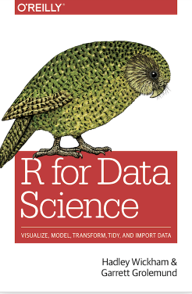
How to Learn R
Books:
R for Data Science – Hadley Wickham and Garrett Grolemund
Hands-On Programming with R – Garret Grolemund
Statistics: An Introduction using R – Michael J. Crawley
Design and Analysis of Experiments with R – John Lawson
Web Applications:
datacamp - https://www.datacamp.com/
YouTube:
Chris Mack – From Data to Decisions https://www.youtube.com/watch?v=JtKK-ERCBI4&list=PLM2eE_hI4gSDnF-mEa9mrIYx7GCLQVN89
StackOverflow
https://r4ds.had.co.nz/index.html

Slide 7
R Overview - Installation
Download from R Cran - https://cran.r-project.org/
If you are just getting started use Rstudio for your Editor. https://posit.co/download/rstudio-desktop/

Slide 8
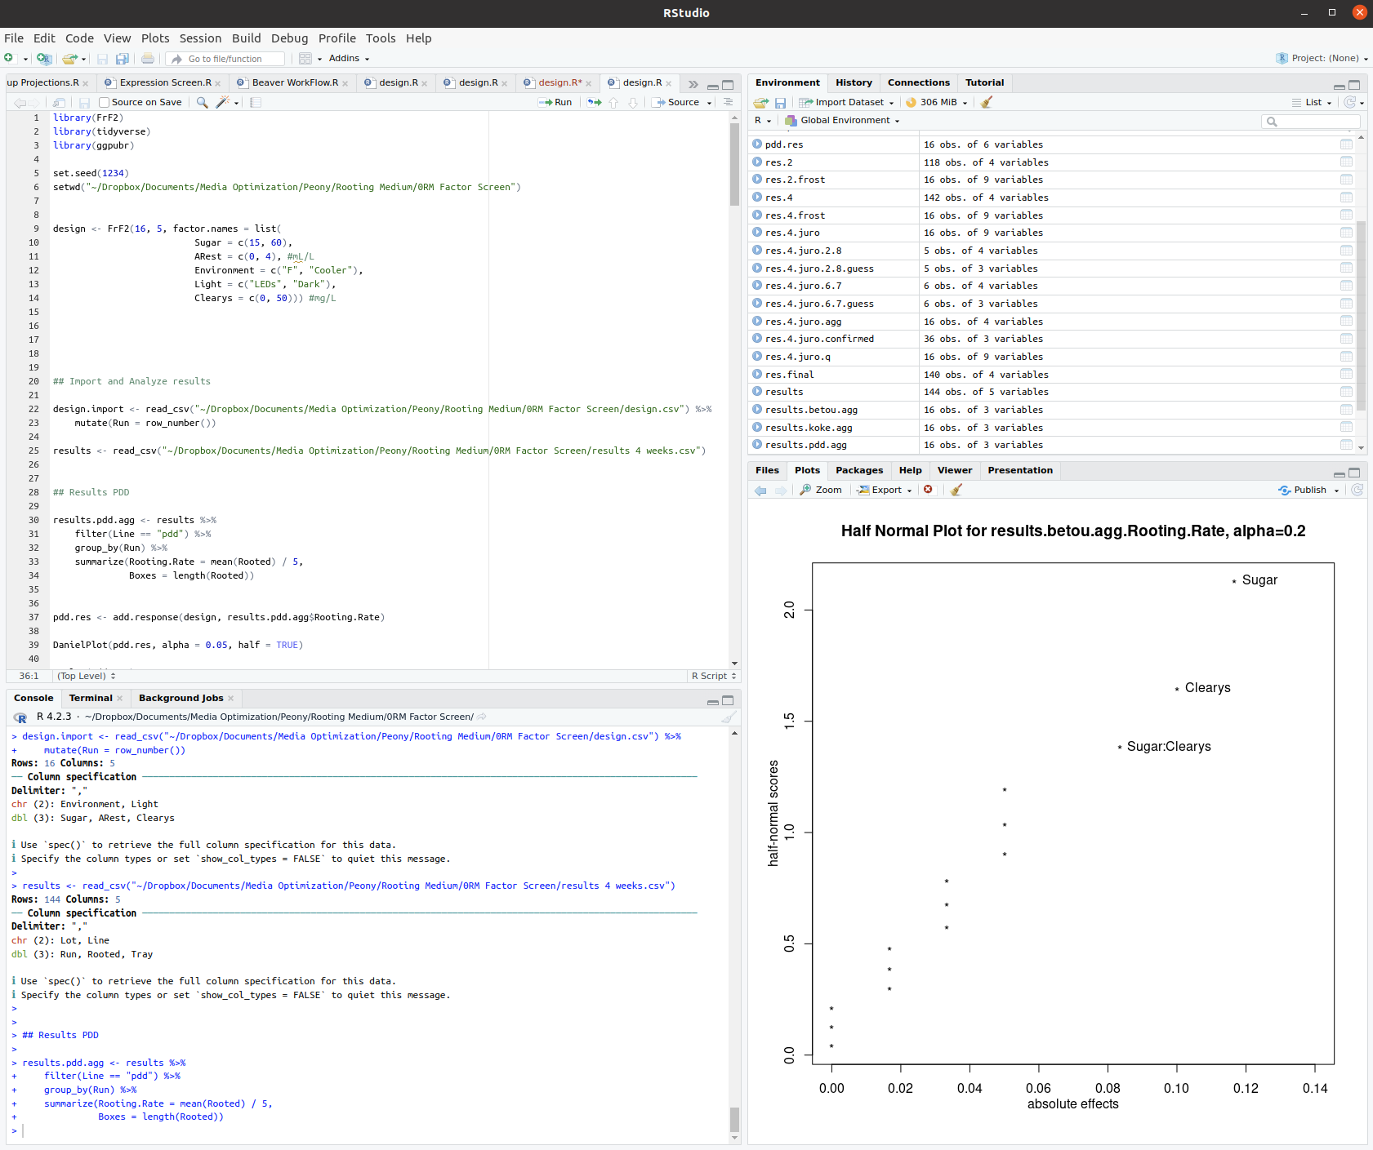
R Overview – Rstudio Overview

Slide 9
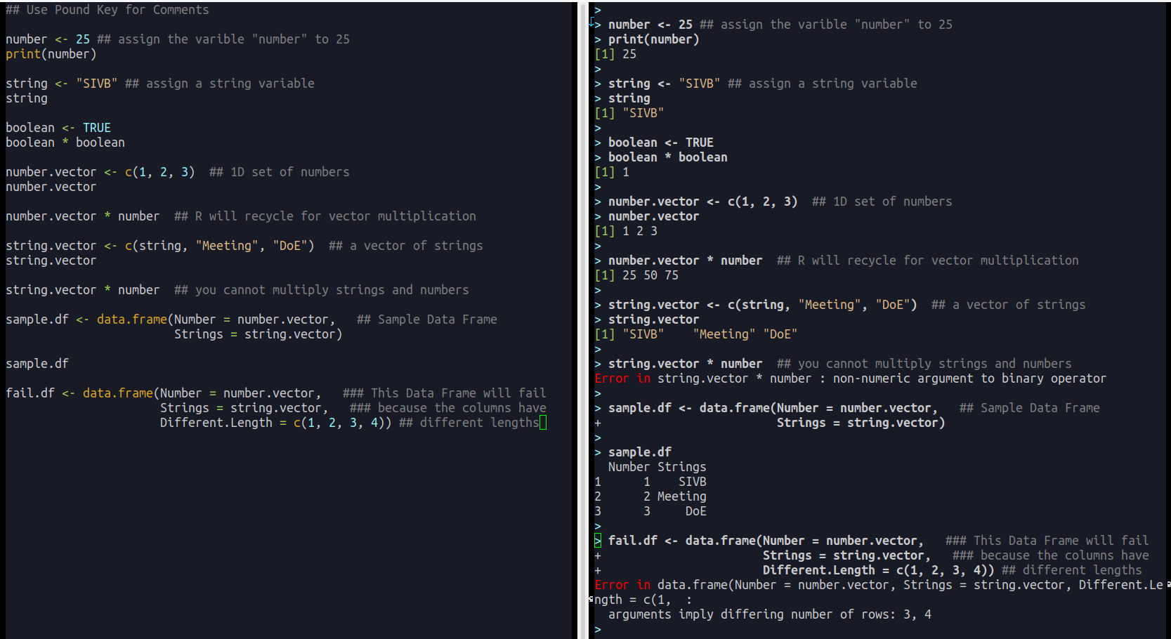
R Overview – Data Structures

Slide 10
R Overview - Packages
Packages are tools made by 3rd party developers to make our lives easy.
tidyverse – collection of tools which make R way easier to learn and work with-- i.e. ggplot2, dplyr, tidyr, readr, modelr, etc.
DoE packages:
FrF2 by Ulrike Gromping for factorial designs https://www.jstatsoft.org/article/view/v056i01
rsm by Russell V. Lenth for response surface methodology https://cran.r-project.org/web/packages/rsm/vignettes/rsm.pdf
mixexp by John Lawson for mixture designs https://www.jstatsoft.org/article/view/v072c02
Exhaustive list can be found on CRAN: https://cran.r-project.org/web/views/ExperimentalDesign.html

Slide 11
R Overview – Packages Continued
To install a package use the general form:
install.packages(“package.name”)
library(package.name)
This basic form usually works, but sometimes you will have to go online and search for solutions to help the install.

Slide 12
R Overview – Dealing with Files
setwd(“~/file location”)-- use this function to set your working directory. This allows you to import and save files in a folder of your choice.
read_csv(“filename.csv”)-- use this basic format to import data into R. You can find an appropriate function of this type to read and write basically any type of data.
write_csv(file.to.save, “file to save.csv”) – function for saving your data so you can read it in later.

Slide 13
R Overview – dplyr
dplyr – makes data manipulation on data frames very easy.
Primarily use the following functions:
mutate(New.Column = Old.Column * 2) – creates a new column based on the algebraic function described.
filter(Plant == “Arabadopsis”) – filters the data frame to only contain the entries which match the booleans.
select(Column.Name) – chooses only the columns of interest
group_by(Plant) %>% summarize(Average.Height = mean(Height)) – to aggregate and transform data.
left_join(connecting.df, by = “Connect.Colum”) – connects two separate data frames by the columns indicated
arrange(Column.to.Sort) – sorts the data based on the columns indicated
Get more help here https://dplyr.tidyverse.org/articles/dplyr.html, or from the R for Data Science book by the package author Hadley Wickham.

Slide 14
R Overview – Plotting Data
There are multiple plotting systems in R. “Base R” has an extremely useful plotting system based around the plot() function.
You should learn ggplot2. There is a free book online (again written by Hadley Wickham) – https://ggplot2-book.org/index.html
Before diving into all of the statistical summaries you should try to visualize your data.
Most of the specific DoE packages have plotting functions to help you use plots specifically relevant to DoE.

Slide 15
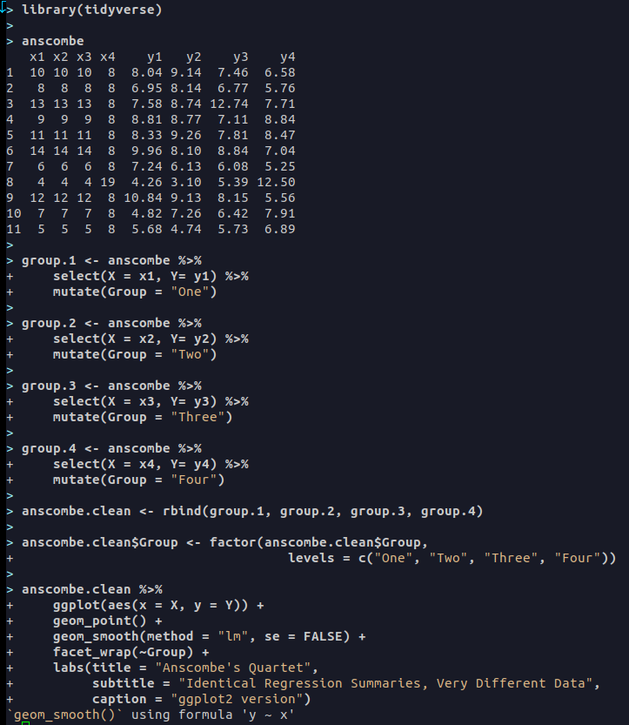
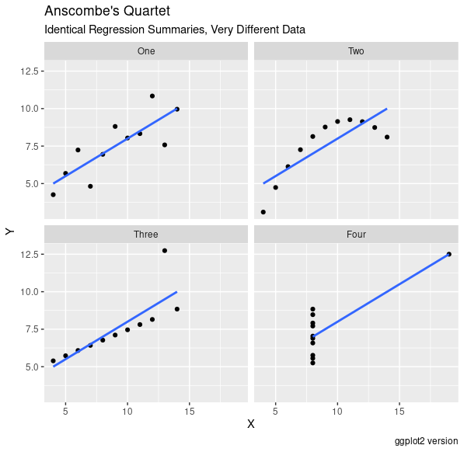
R Overview – Anscombe’s Quartet ggplot2

Slide 16
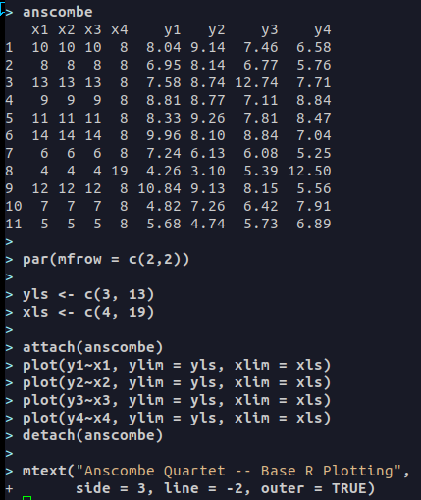
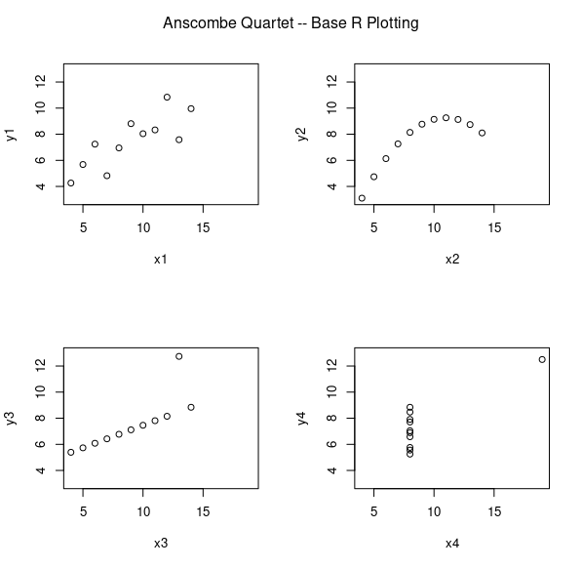
R Overview- Anscombe’s Quartet Base R

Slide 17
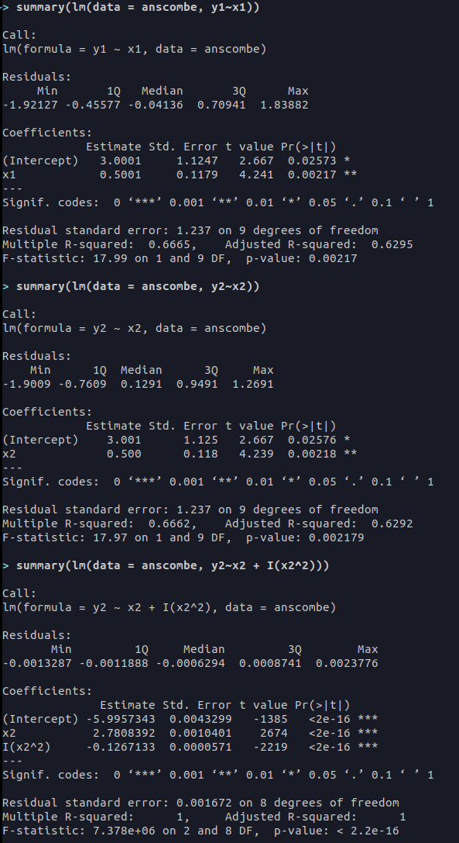
R Overview – Anscombe’s Quartet Regression
lm() - function allows you to create a regression model
summary(lm.model) – shows you the regression summary
“Estimate” - shows the effect size for the coefficient
Std. Error – the average distance the observed variables fall from the regression line.
T value – shows the size difference relative to the variation in your data.
Pr- the “probability” that the effect is significant.
Multiple R-squared – how much variability in the data is explained by the model
Adjusted R-squared – the amount of variability in the data is explained in the model, but it is penalized by the number of explanatory variables.
P-value – indicates if there is a significant relationship described by the model.
You have to use the I() function in the lm() model for polynomial regression.

Slide 18
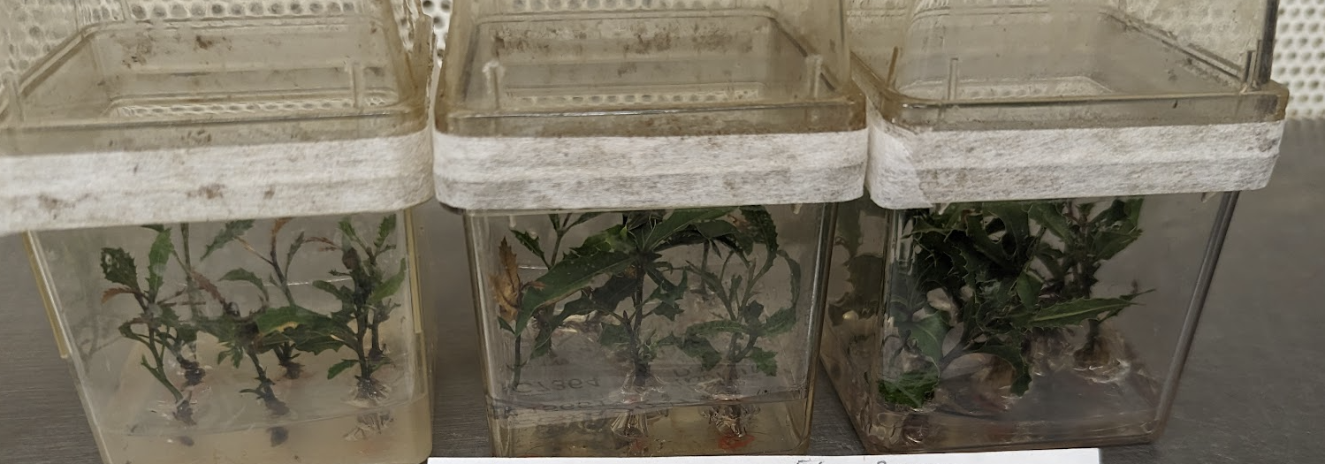
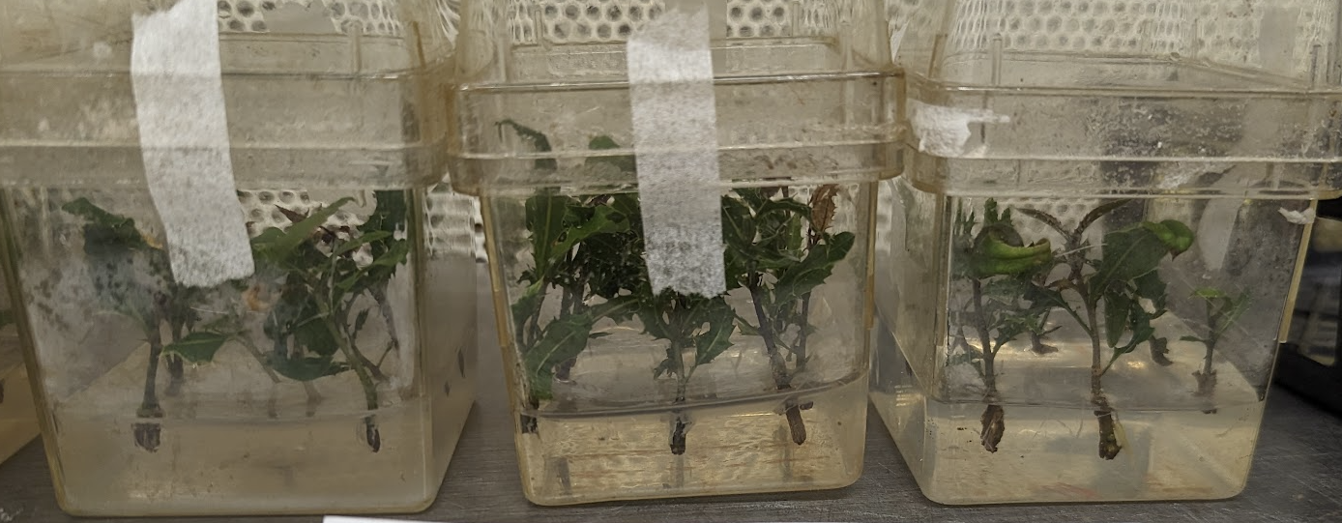
DoE with R – CRD One-Factor – 1
Goal: Optimize the Effect of IBA on Rooting
Steps:
Set Up Environment
Create and Randomize Design
Export Design for Later Use
Determine Experiment Size
Import Results
Visualize Data
Fit Models to Data
Check Model Assumptions with Diagnostic Plots
Confirm Results in Follow-Up Experiment
IBA Level: 5.5 mg/L (Run 1)
IBA Level: 1 mg/L (Run 6)

Slide 19
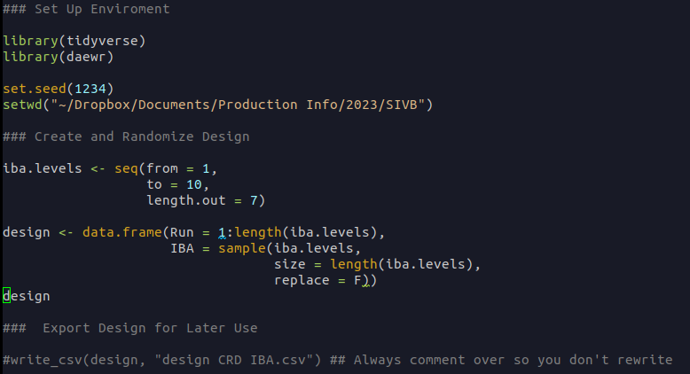
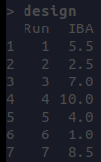
DoE with R – CRD One-Factor – 2
Goal: Step 1, 2, 3 - Set Up the Environment and Design the Experiment

Slide 20
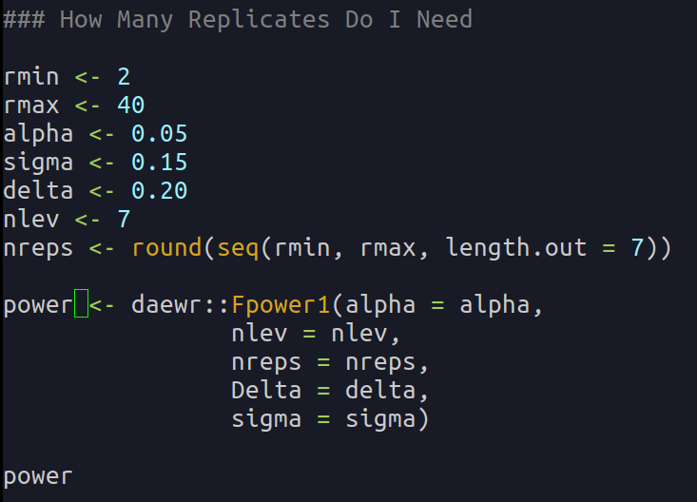
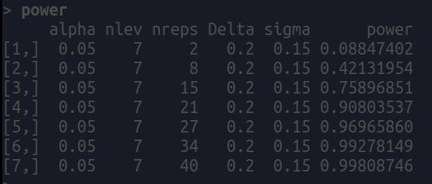
DoE with R – CRD One-Factor – 3
Goal: Step 4 – Determine the Number of Replicates (Power Analysis)
From this we can see that, if we use 21 replicates, we would have a 90.8% chance of detecting a rooting rate difference of 0.2 if the standard deviation is 0.15 – if all of our assumptions are actually true...
(see pg 38 of Lawson Design and Analysis of Experiments with R)

Slide 21
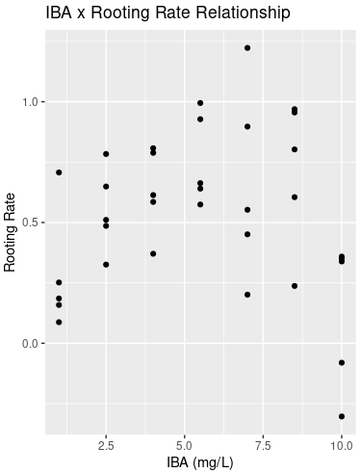
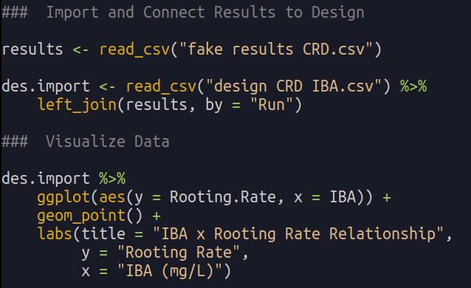
DoE with R – CRD One-Factor – 4
Goal: Step 5, 6 – Import Design and Results / Visualize Data

Slide 22
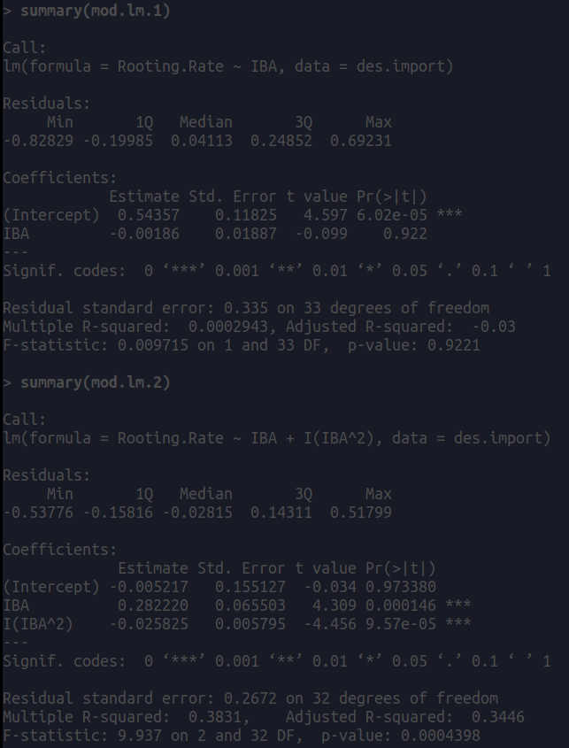
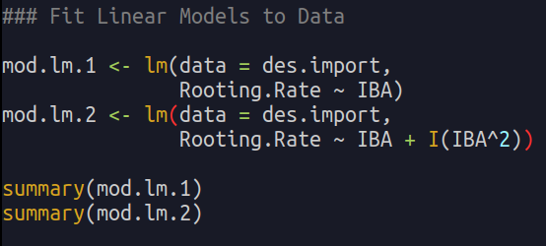
DoE with R – CRD One-Factor – 5
Goal: Step 7 – Fit Models to Data
As you can see from the regression summary, the quadratic model explains more of the experimental variation.
It is important to note, that if I aggregated the data before, the R-squared values would increase.

Slide 23
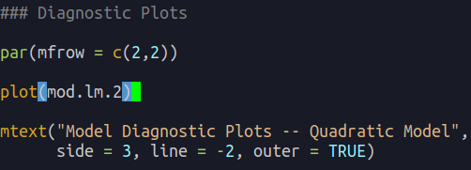
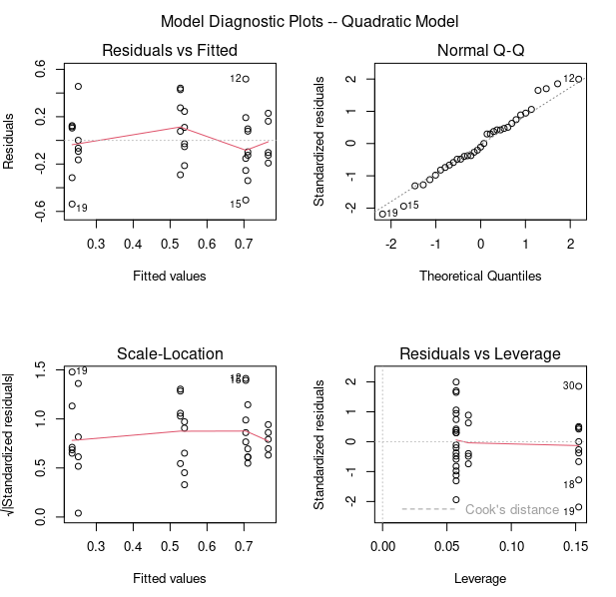
DoE with R – CRD One-Factor – 6
Goal: Step 8 – Check Model with Diagnostic Plots
(see pg 38 of Lawson Design and Analys​is of Experiments with R)
Check to see if the variance is constant (residuals vs. fitted)
Check for normality (Q-Q Plot)
If these assumption fail you can try to transform your data using a Box-Cox plot.

Slide 24
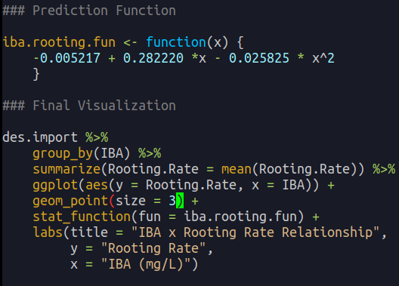
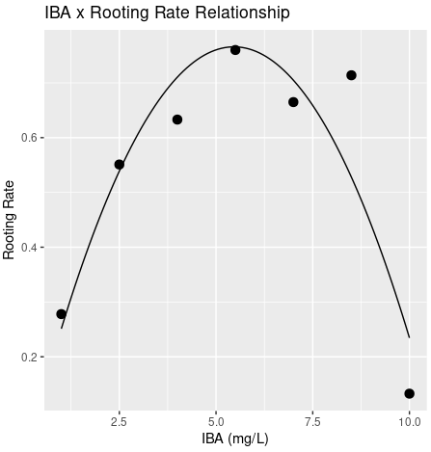
DoE with R – CRD One-Factor – 7
Goal: Step 9 – Make Results Presentation Ready then a Follow Up Experiment
Make a follow up medium with ~5.25 mg/L IBA. Test compared the current media to see if it is better.

Slide 25
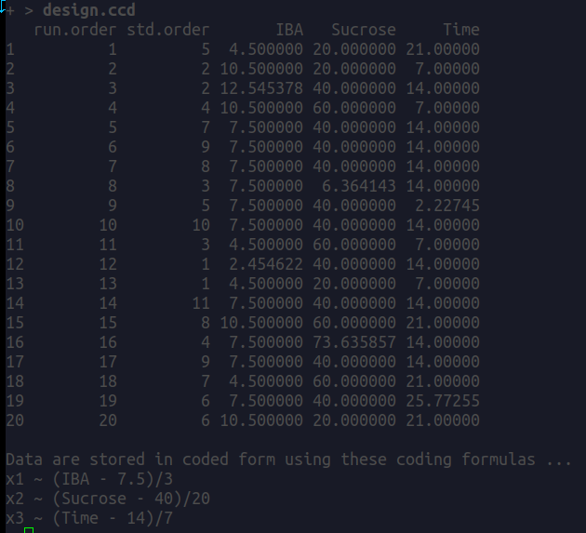
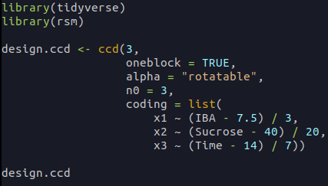
Doe with R – Response Surface Design 1

Slide 26
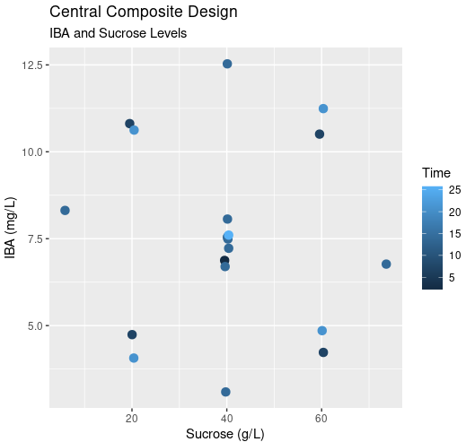
Doe with R – Response Surface Design 2

Slide 27
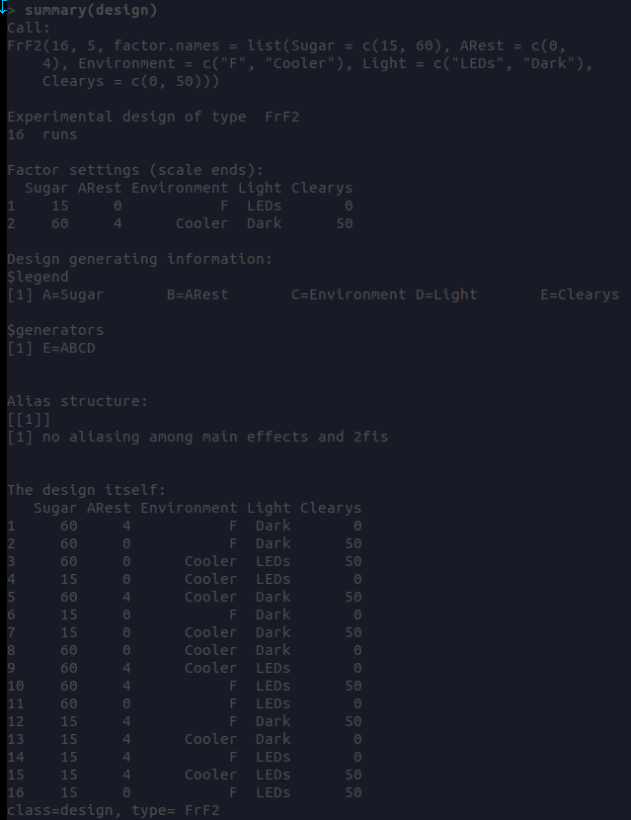
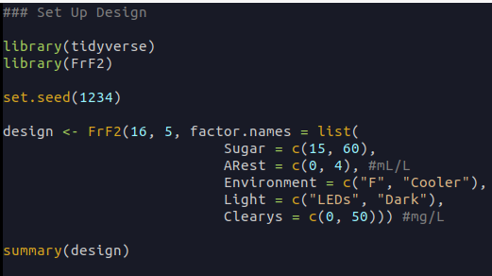
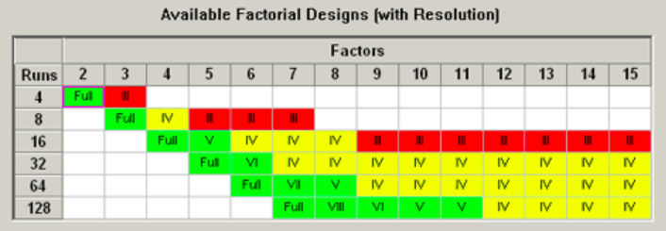
DoE with R – Fractional Factorial Design 1
How to Set Up a Design
(See Gromping et all, 2014)

Slide 28
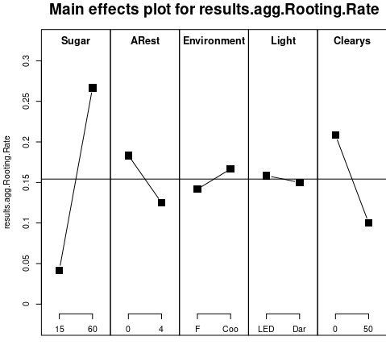
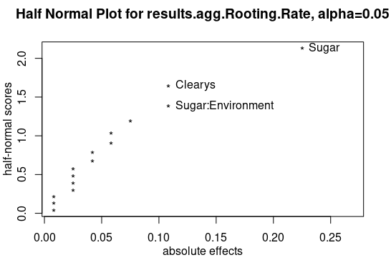
DoE with R – Fractional Factorial Design 2
Easy Diagnostic Plots with FrF2 Package

Slide 29
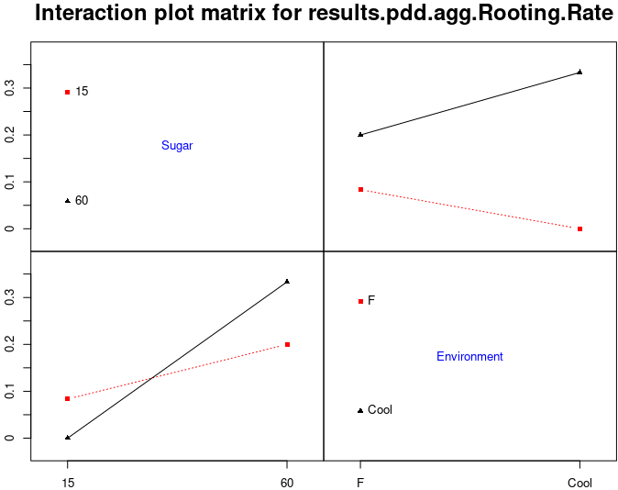
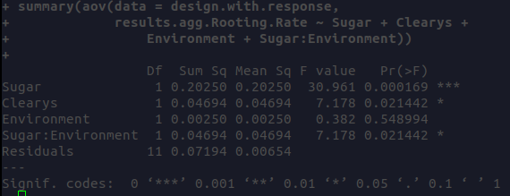
DoE with R – Fractional Factorial Design 3
Interaction Plot and AOV Example

Slide 30
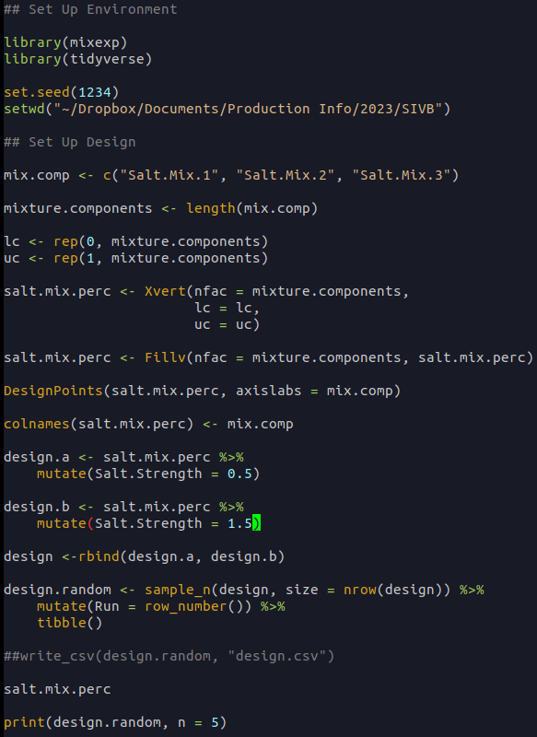
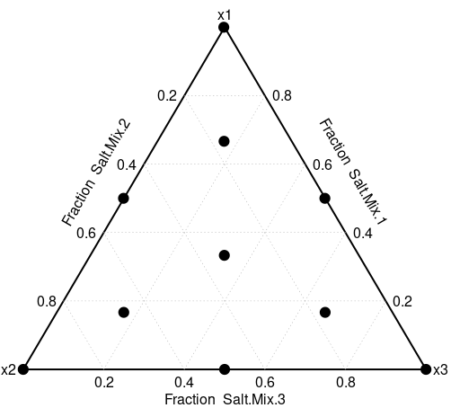
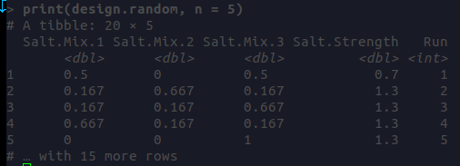
DoE with R – Mixture-Process Example
How to Set Up a Mixture Design

Slide 31
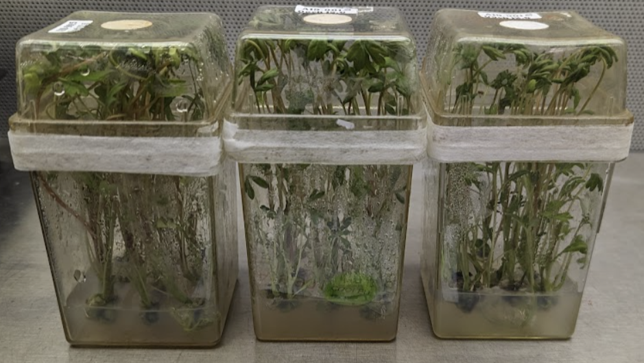
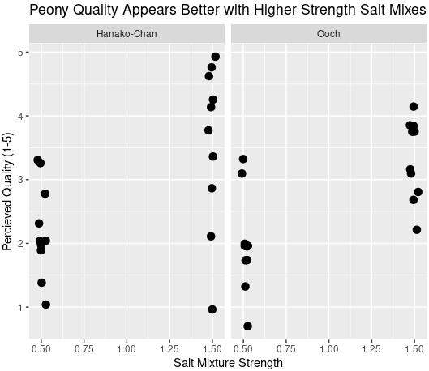
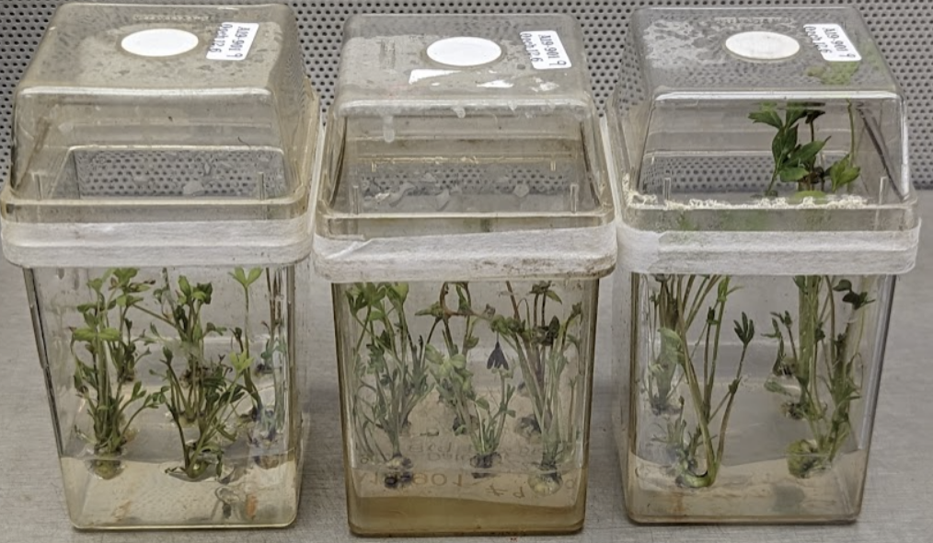
DoE with R – Mixture-Process Example 2
Overall Visualization of Data
Example Quality = 5
Example Quality = 1

Slide 32
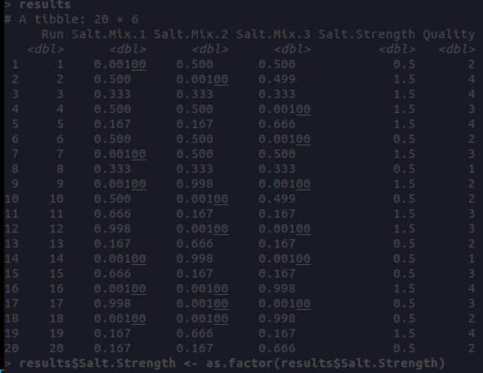
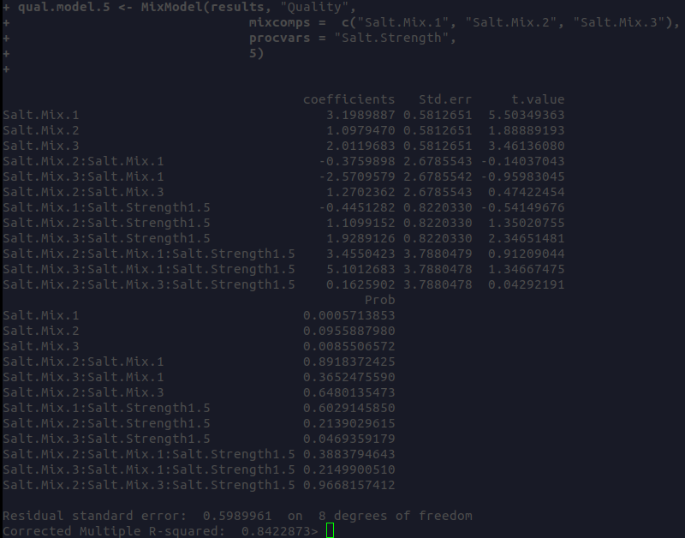
DoE with R – Mixture-Process Example 3
Fitting a Mixture-Process Model
Feed a result data frame in this format into the MixModel function to model mixture data with the mixexp package.
See: Mixture Experiments in R using mixexp (Lawson et all 2016)

Slide 33
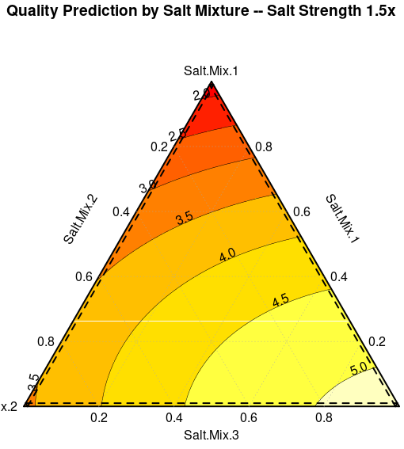
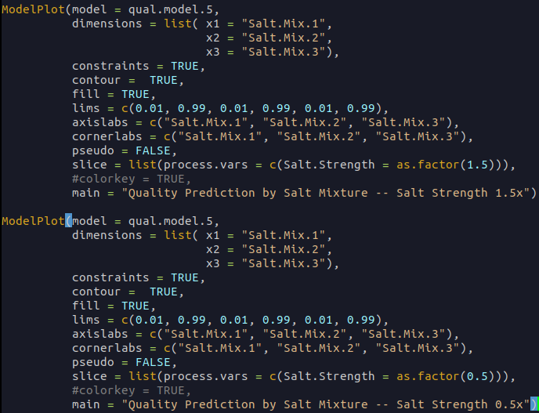
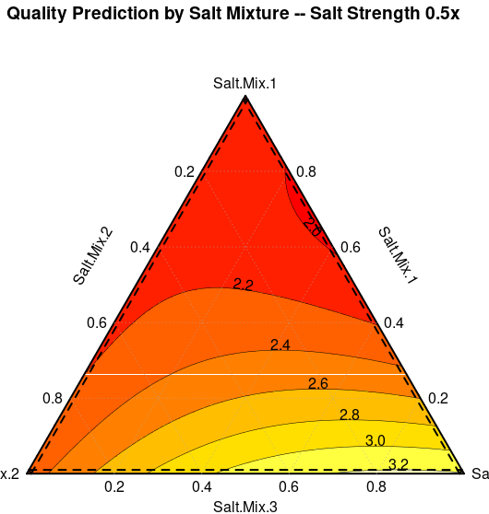
DoE with R – Mixture-Process Example 3
Visualizing the Predictions of a Mixture-Process Model

Slide 34
DoE with R
Thank You!
Please feel free to contact me at brett.gytri@tissuegrown.com if you have any questions about R or DoE. Thanks!

